Slide 1


Generative AI
Full Stack Developer

Slide 2
Course C :
Developing Applications with LLM

Slide 3
01 - Introducing LangChain
Inputs & Outputs + Prompt Templates

Slide 4





Agenda
Inputs/Outputs
Prompt Templates
Chat prompt Template
Examples
Best Practices
Objectives:
Guide to passing data through chains
Building Dynamic Prompts

Slide 5


What is a Chain?
A chain is a callable composition of components
(LLMs, Prompt Templates, Tools, Retrievers)
Chains accept a dictionary of inputs and return a dictionary of outputs.

Slide 6



Inputs & outputs - Core Idea
Inputs: Named variable passed in to a chain
{"question": "..."}
Outputs: Results returned from the chain
{"answer": "...", “sources”: [...]}
Dicts. Keeps the flow explicit and composable

Slide 7


How Data flows between Steps
Step A
Step B
Step C
Process user query and context
Format response with
citations
Final delivery to user
{"query": "...",
"context": "..."}
{"result_a": "...",
"metadata": {...}}
{"input": "
{{result_a}}", "style":
"..."}
{"response": "...",
"sources": [...]}
{"response": "...",
"user_id": "..."}
{"answer": "...",
"sources": [...]}}

Slide 8

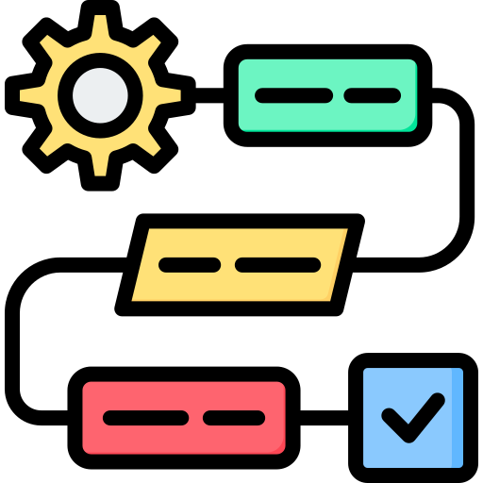

Runnable & RunnableSequence
Runnable: Abstract logic composition (sync/async, parallel) for consistent interface across components
RunnableSequence / RunnablePassthrough: Help forward data through multi-step workflows
Example:
chain = prompt | model | output_parser

Slide 9

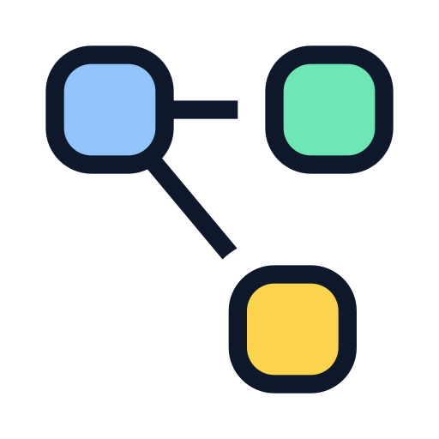
Passing Values Unchanged — Passthrough
Use RunnablePassthrough to carry values forward unchanged (e.g.,
user_id , context blob).
Helpful when branching or using parallel steps that later need access to original inputs.

Slide 10
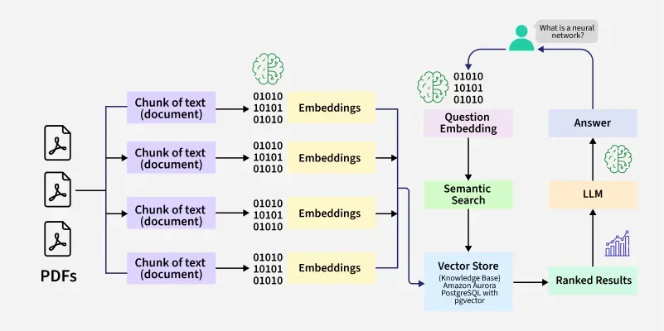
Example: Simple Sequential Flow

Slide 11




Example: Simple Sequential Flow
PromptTemplate formats instruction → LLM
# Define a prompt template
template = "Explain {concept} in simple terms."
prompt = PromptTemplate(template=template, input_variables=["concept"])
# Format and send to LLM
formatted_prompt = prompt.format(concept=user_input)
{"user_input": "quantum computing"}
LLM answer → output draft
# Process LLM response
draft = {
"explanation": result.content,
"timestamp": get_timestamp()
}
{"summary": "Quantum computing uses quantum bits..."}
summarize_chain takes draft → final summary
# Summarize the draft explanation
final_output = summarize_chain.invoke({
"text": draft["explanation"],
"max_words": 50
})
# Return the summarized content
return {"summary": final_output["summary"]}

Slide 12


Error Handling & Validation for Outputs
Validate outputs (parse JSON, check required keys) to ensure data quality.
Use OutputParsers to enforce schemas and retry on parse errors. (LangChain tooling available.)

Slide 13

PromptTemplate — What & Why
PromptTemplate: a templated string that accepts variables and formats the prompt for an LLM.
Supports popular templating
f-strings
jinja2
mustache
Great for reuse and consistency.

Slide 14
PromptTemplate — Example
Define the Template
# Create a template for summarization in different languages
template = "Summarize this text in {language}:\n\n{text}"
# Initialize the PromptTemplate with variable names
prompt = PromptTemplate(
template=template,
input_variables=["language", "text"]
)
{"language":"Hindi","text":"..."}
Use the Template with Variables
# Prepare variables for substitution
variables = {
"language": "Hindi",
"text": "Artificial intelligence is transforming how businesses operate..."
}
# Format the template with variables
formatted_prompt = prompt.format(**variables)
Returns the filled prompt string
summarize_chain takes draft → final summary
Summarize this text in Hindi:
Artificial intelligence is transforming how businesses operate...

Slide 15



Why Use Templates (Benefits)
Reproducible prompts for testing and evaluation.
Easier A/B testing, localization, and parameterization.
Separates prompt content from code (better maintenance).

Slide 16


ChatPromptTemplate — Chat-aware Prompts
ChatPromptTemplate builds multi-message chat prompts with
system/human/assistant roles.
Useful for ChatModels with role-aware context and system instructions.

Slide 17
ChatPromptTemplate — Structure Example
Define message templates for different roles
from langchain.prompts import ChatPromptTemplate, SystemMessagePromptTemplate, HumanMessagePromptTemplate
# System message template
system_template = "You are an assistant that helps with {task}."
system_message = SystemMessagePromptTemplate.from_template(system_template)
System: "You are an assistant that helps with {task}."
Create human message template with variables
# Human message template
human_template = "{user_query}"
human_message = HumanMessagePromptTemplate.from_template(human_template)
Human (Previous): [Messages from chat_history]
Assistant (Previous): [Responses from chat_history]
Compose ChatPromptTemplate with message history
from langchain.prompts import MessagesPlaceholder
# Compose full chat template with history
chat_prompt = ChatPromptTemplate.from_messages([
system_message,
MessagesPlaceholder(variable_name="chat_history"),
human_message
])
Human (Previous): "{user_query}"

Slide 18


Dynamic Prompts & Few-shot Examples
Insert dynamic examples or few-shot pairs into templates to guide behavior.
Use example selectors (length, similarity, or MMR) to pick the best examples
at runtime.

Slide 19




Multimodal Prompts & Inputs
LangChain supports multimodal inputs (images, audio) via provider-specific formats or cross-provider standard.
Templates can include placeholders for non-text data references.

Slide 20


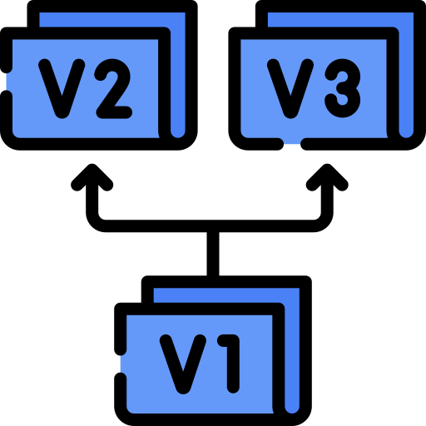
Best Practices — Prompt Templates
Keep templates small & focused; avoid leaking private data.
Parameterize where possible; use OutputParsers for structured outputs.
Track prompt versions (for reproducibility).

Slide 21
Putting it Together — End-to-End Example
User Question
ChatPromptTemplate
Chat Model
Input query from user
Builds chat messages
LLM processes
messages
{"user_query": "..."}
{"user_query": "..."}
{"messages": [...]}
{"messages": [...]}
{"response": "..."}
OutputParser
Next Chain
Final Answer
Transforms to
structured JSON
COnsumes structured data
Result delivered to user
{"response": "..."}
{"parsed_json": {...}}
{"parsed_json": {...}}
{"processed": "..."}
{"processed": "..."}
{"answer": "..."}
Complete chain: from user input to structured response with variable mapping
OutputParser ensures consistent structure for downstream components
Multiple specialized components work together through defined interfaces

Slide 22


Common Pitfalls & Debugging Tips
Common Pitfalls:
Mismatched variable names between chain steps
Unparsed outputs causing downstream failures
Token limits exceeded in prompt templates
Debugging Tips:
Attach callbacks/logging to inspect chain execution
Run in small steps to isolate failures
Assert expected keys exist in outputs

Slide 23
Resources & Next Steps
Official Documentation
LangChain How-to Guides & API Reference
Prompt Engineering Best Practices
Code Examples
LangChain GitHub Repository
Community Examples & Templates
Learning Resources
Tutorials & Walkthroughs
Community
Discord Community & Support
Twitter: LangChainAI
Try This
Build a two-step chain (summarize → question answer) using PromptTemplate + ChatPromptTemplate.
Practice combining these components into a cohesive workflow with proper input/output handling.

Slide 24
Q/A

Slide 25
Thanks

